Slide 1
AI Tools for Communication and Language
(أدوات الذكاء الاصطناعي للتواصل واللغة)

Slide 2
outline
Navigating the AI Landscape (التنقل في عالم الذكاء الاصطناعي)
Voice API for Real-time Interaction (واجهة برمجة التطبيقات الصوتية للتفاعل الفوري)
Seamless Language Bridging (جسر لغوي سلس)
Versatile AI Assistant (مساعد ذكاء اصطناعي متعدد الاستخدامات)
AI-Powered Image Generation (توليد الصور المدعوم بالذكاء الاصطناعي)
Visual Insight for All (رؤية بصرية للجميع)
Intelligent Content Generation (توليد المحتوى الذكي)
Data-Driven Insights (رؤى قائمة على البيانات)
AI for Sound and Audio Analysis (الذكاء الاصطناعي لتحليل الصوت والصوتيات)

Slide 3

Navigating the AI Landscape
Artificial Intelligence is rapidly transforming how we interact with information and create content. This presentation explores cutting-edge AI tools designed to enhance translation, deepen visual analysis, and streamline content generation.
1
2
3
Translation
Visual Analysis
Content Creation
Breaking language barriers with advanced AI.
Extracting insights from complex imagery.
Generating diverse and engaging material efficiently.

Slide 4


VAPI AI: Voice API for Real-time Interaction
VAPI AI provides a powerful voice API that enables real-time, natural language interactions, making conversations with AI seamless and intuitive.
Website Link
Practical Example
https://vapi.ai
Develop a customer service chatbot that can understand and respond to user queries through natural voice commands, providing instant support and information.
How to Use
Integrate the VAPI AI SDK into your application.
Configure voice models and language settings.
Initiate real-time voice conversations.
Receive and process AI-generated responses.

Slide 5

Immersive Translate: Seamless Language Bridging
Immersive Translate offers an advanced translation solution that integrates directly into your browsing experience, providing instant, context-aware translations.
Website Link
Practical Example
https://immersivetranslate.ai
Read academic papers or news articles in foreign languages with instant translations, making global research more accessible and efficient.
How to Use
Install the browser extension.
Select your desired source and target languages.
Hover over text or click to translate specific elements.
Experience real-time, in-context translation as you browse.

Slide 6
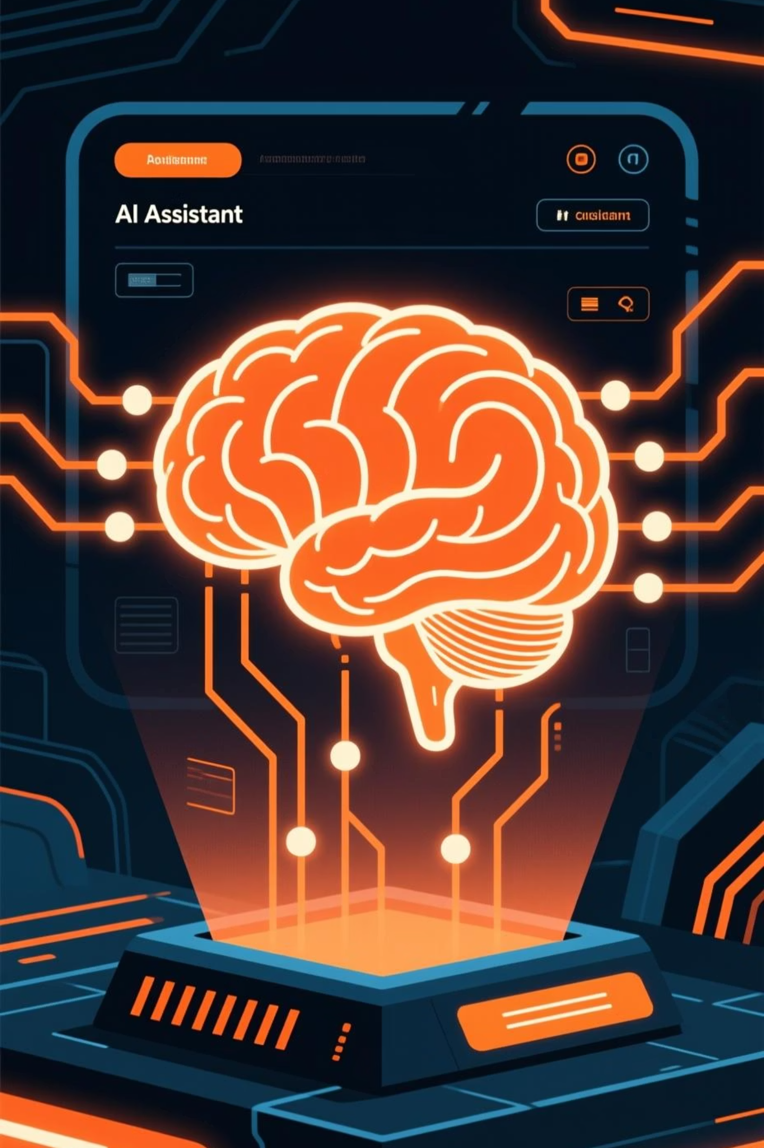

Gimini: Versatile AI Assistant
Gimini is a multifaceted AI assistant capable of performing a wide range of tasks, from generating text and code to answering complex questions and summarizing documents.
Website Link
Practical Example
https://gimini.ai
Generate a first draft of a research paper's literature review by providing key topics and desired sources, saving hours in initial writing stages.
How to Use
Access the Gimini web interface or API.
Input your query or prompt for content generation.
Refine output with iterative commands.
Utilize for brainstorming, coding, or data synthesis.

Slide 7

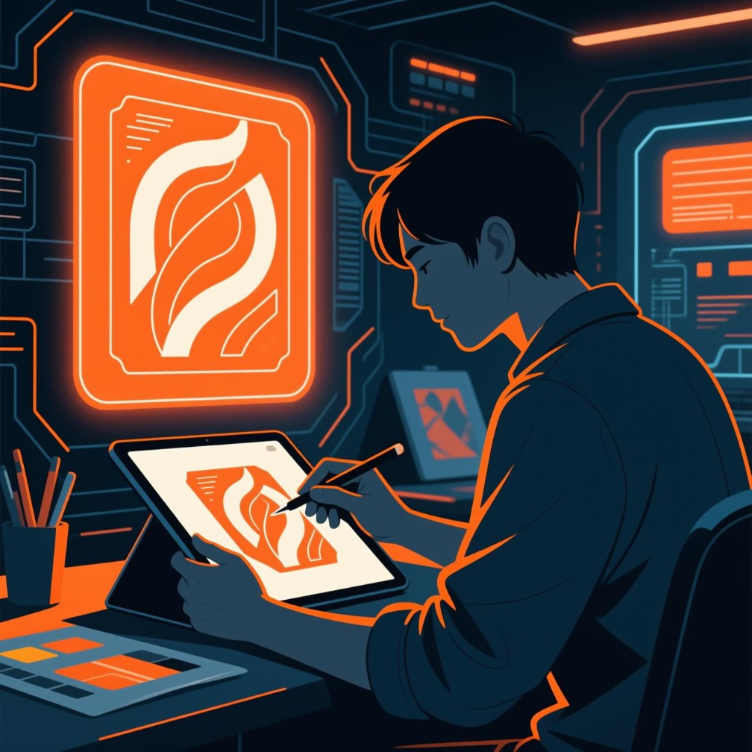
Portraits: AI-Powered Image Generation
Portraits leverages advanced AI to create stunning, unique images and artistic renditions from simple text prompts, offering a new dimension to visual content creation.
Website Link
Practical Example
https://portraits.ai
Design unique visual assets for a presentation or social media campaign by generating bespoke images that perfectly match the desired theme and aesthetic.
How to Use
Visit the Portraits website.
Enter a descriptive text prompt for your desired image.
Adjust style parameters and artistic preferences.
Generate and refine your AI-created artwork.

Slide 8

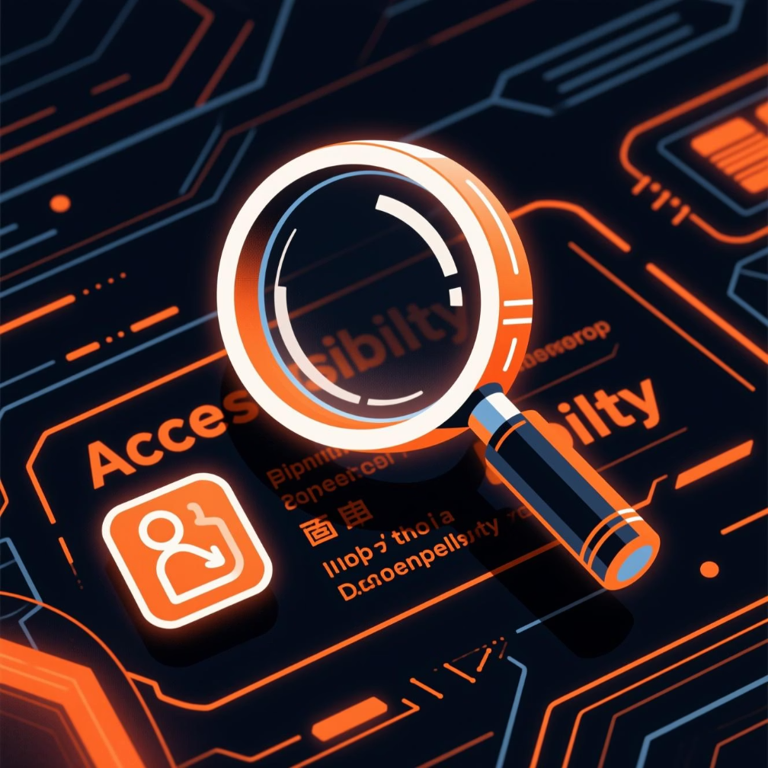
Gimini Seeing AI: Visual Insight for All
Gimini Seeing AI is an innovative tool that uses AI to describe the world, providing visual information for the visually impaired and enhancing accessibility through intelligent image analysis.
Website Link
Practical Example
https://gimini.ai/seeing
A visually impaired student can use Gimini Seeing AI to read printed handouts, identify people in a room, or describe objects in a laboratory setting, fostering independence.
How to Use
Launch the Gimini Seeing AI application.
Point your device's camera at an object or scene.
Receive real-time audio descriptions of visual elements.
Utilize for text recognition, currency identification, and scene description.

Slide 9


GenSpark: Intelligent Content Generation
GenSpark is an AI-powered platform designed to automate and optimize various aspects of content creation, from initial brainstorming to drafting and refinement.
Website Link
Practical Example
https://genspark.ai
Generate multiple social media posts based on a single news article, ensuring consistent messaging and adapting the tone for different platforms.
How to Use
Define your content requirements and target audience.
Provide keywords and main topics for your content.
GenSpark generates various content formats (articles, summaries, posts).
Review and edit the AI-generated content to match your brand voice.

Slide 10


Project Mariner: Data-Driven Insights
Project Mariner offers advanced AI-driven data analysis capabilities, helping users uncover hidden patterns and make informed decisions from vast datasets.
Website Link
Practical Example
https://projectmariner.ai
Analyze student performance data to identify correlations between study habits and academic success, informing educational strategies and personalized learning paths.
How to Use
Upload your dataset to the platform.
Specify the type of analysis you require (e.g., trend analysis, anomaly detection).
Project Mariner processes the data and presents key findings.
Interpret the insights to guide strategic planning.

Slide 11

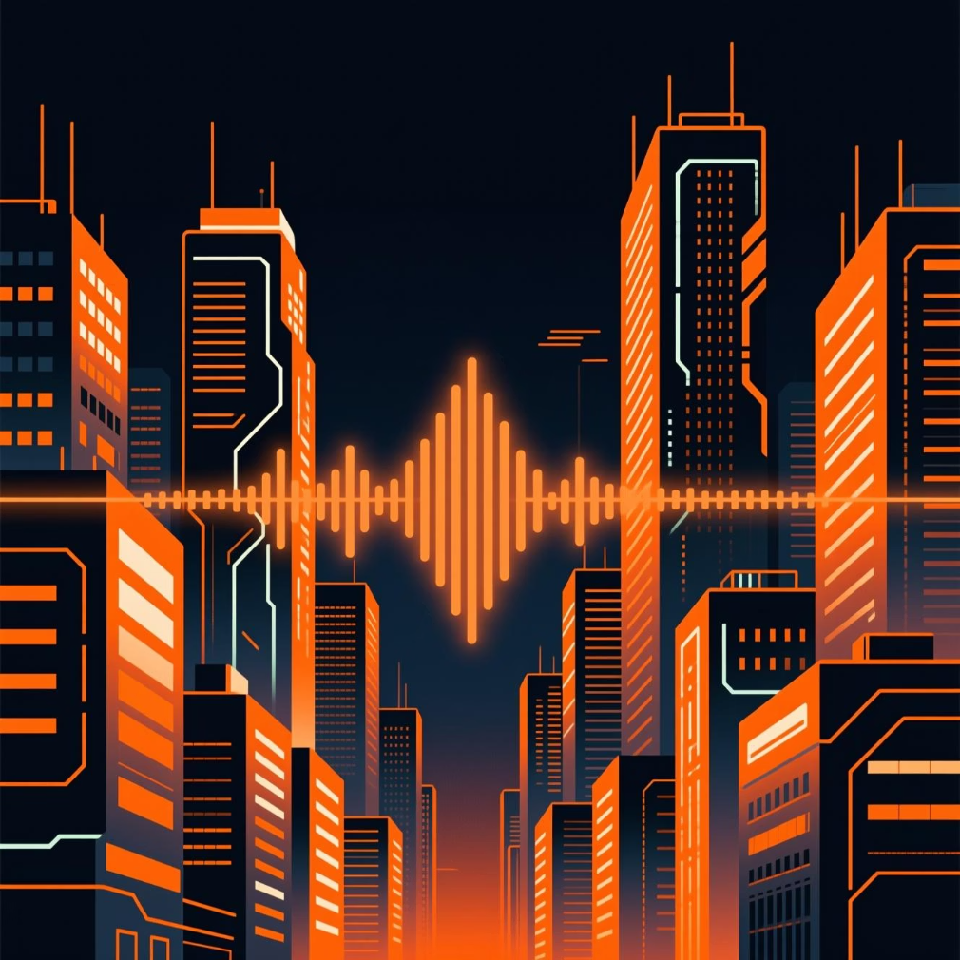
Rumore: AI for Sound and Audio Analysis
Rumore utilizes AI to analyze and interpret sound, enabling advanced applications in acoustic monitoring, environmental analysis, and speech recognition.
Website Link
Practical Example
https://rumore.ai
Monitor urban noise levels to identify sources of pollution and develop targeted interventions for improving city soundscapes and resident well-being.
How to Use
Integrate Rumore's API into your audio processing pipeline.
Feed audio data for real-time or batch analysis.
Configure AI models for specific sound identification tasks.
Receive detailed reports on detected audio events and patterns.

